Slide 1
Loan Approval System
By
Arham Lodha J031
Ahnaan Merchant J036
Nishant Parekh J046
Anshul Savla J053

Slide 2
Welcome To Dream Housing Finance!!
I Nishant Parekh along with my team is here to help you buy your dream house by providing a you a smooth automated loan process without any stress!!! ☺
Just Focus On getting your interior done and Book your one day trip to IKEA as soon as possible and leave the Loan Process to ME and My amazing team.
So Before We start Let Me Intoduce you to my team :-
Nishant Parekh – Data Collector And Visualizer
Arham Lodha – Data Engineer
Ahnaan Merchant - Pre processor and Feature Engineer
Ansul Savla – Model Trainer

Slide 3
Importing Libraries And The Data
Import Relevant Libraries like : -
Pandas
Numpy
Seaborn
Matplotlib
Import The Test And Train Data Set
Study the Data-Set and Target Variable using different Visualizing Methods.

Slide 4
Finding Relations And Visualizing The Data
Plotted A Heat-Map to see the overall co-relation of different features in the data
Strong Co-relation between Applicant Income and Loan Amount
Find all Categorical Data And Plot A Bar plot and study them Independently
After Studying them Independently Visualize their effect on our Target Variable
Find Null Values And Fill Them for better results

Slide 5
Checking of Skewness And Identifying Outliers
Plot Histogram and understand the effects of 2 Continous Variable on the Target Variable
Applicant Income
Co-Applicant Income
Create Box Plots To study the Mean, 1st Quarter, 3rd Quarter of the Variable and understand the mathematical part of the Variable
Using the help of Box Plot, Bar plot and Cat Plot we have found the Outliers ( Difference between 3rd and 1st Quartile )

Slide 6
Dealing with Outliers
Discovering Outliers using visualization tools
Boxplot
Scatterplot
Discovering and eventually eliminating Outliers using mathematical functions
Z – score
IQR Score

Slide 7
Feature Engineering
What is Feature Engineering
How did we come up with new attributes , that acted as supplements to our existing dataset .
Some Examples include :
Calculation of EMI
Finding Total Income

Slide 8
Label Encoding
In label encoding in Python, we replace the categorical value with a numeric value between 0 and the number of classes minus 1. If the categorical variable value contains 5 distinct classes, we use (0, 1, 2, 3, and 4).
Ordinal scale has all its variables in a specific order, beyond just naming them. Interval scale offers labels, order, as well as, a specific interval between each of its variable options. So for ordinal variables we cannot use label encoding either we can use One hot Encoding or we can manually map ubu creating a custom dictionary.

Slide 9
Train Test Split
The train-test split is a technique for evaluating the performance of a machine learning algorithm.
It can be used for classification or regression problems and can be used for any supervised learning algorithm.
The procedure involves taking a dataset and dividing it into two subsets. The first subset is used to fit the model and is referred to as the training dataset. The second subset is not used to train the model; instead, the input element of the dataset is provided to the model, then predictions are made and compared to the expected values. This second dataset is referred to as the test dataset.
Train Dataset: Used to fit the machine learning model.
Test Dataset: Used to evaluate the fit machine learning model.
The objective is to estimate the performance of the machine learning model on new data: data not used to train the model.
Here we split our data in ratio of 80:20 i.e. 80% is out training data and 20% is our testing data.

Slide 10
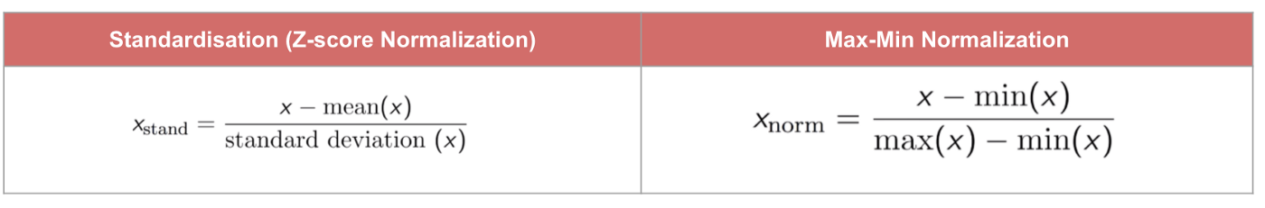
Standard Scaling
Standardisation is a scaling technique where the values are centred around mean with a unit standard deviation and mean of attributed becomes zero.
Normalisation is good to use when we do not have gaussian distribution but generally normalization is used for models like knn and neural network.In general we use standadisation since it is not affected by outliers and it works better compared to normalisation.At the end of the day we use scaling technique which works better.
It is good practice to fit scaler on training data and then use it to transform testing data to avoid data leakage

Slide 11
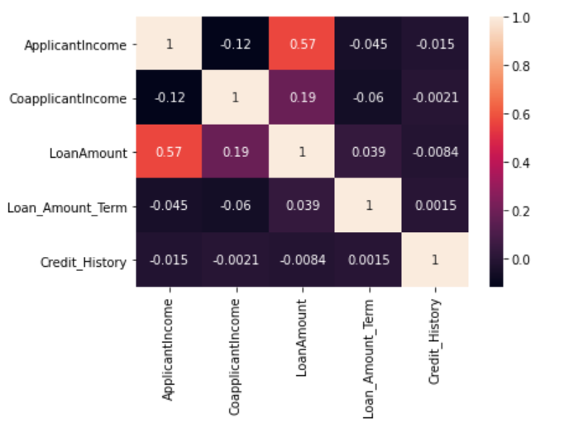

Feature Selection
1) TEST FOR MULTICOLLINEARITY
A correlation matrix is a tabular data representing the ‘correlations’ between pairs of variables in a given data.
There are several types of correlation coefficients, but the most common of them all is the Pearson’s coefficient denoted by the Greek letter ρ (rho).
Best way to visualize correlation is by looking at heatmap.

Slide 12
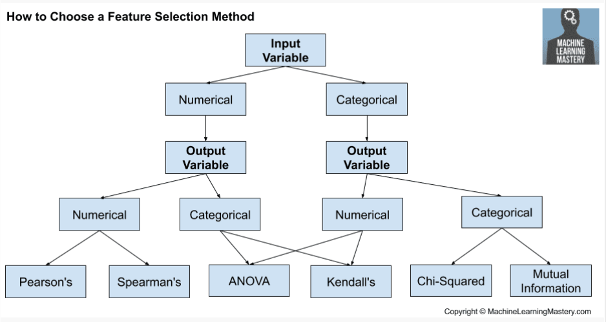
2)Filter Method
As our y variable is categorical variable we used ANOVA test and chi – square test for feature selection and we also used wrapper methods for feature selection which are mentioned in the next slide and we selected the best set of feature which yields better accuracy.

Slide 13
Wrapper Methods
Sequential feature selection
Forward
Backward
Exhaustive Feature Selection
Recursive Feature Elimination

Slide 14
Training a model →

Slide 15
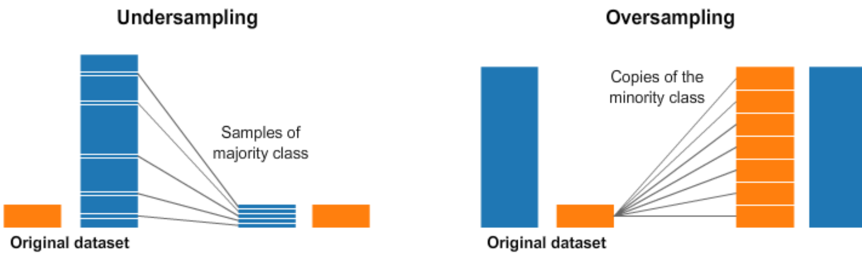
Oversampling and Undersampling

Slide 16
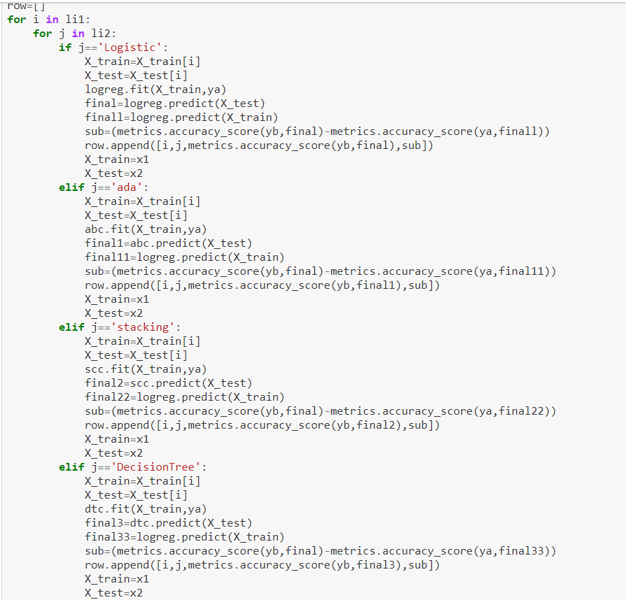
Auto – ML Function

Slide 17
So we have taken almost 10 – 12 models and after selecting best baseline models from above function we applied various techniques on that selected models
Grid Search Cv
Randomised Search Cv
Cross validation
Evaluating training and testing error
Changing the threshold value using roc – auc score
But in these notebooks we fine tuned each and every model since this project was more of for the learning and understanding aspect

Slide 18


